Slide 1
CSE 2217: Data Structure and Algorithms
Introduction
Proof By Induction
Asymptotic notation

Slide 2
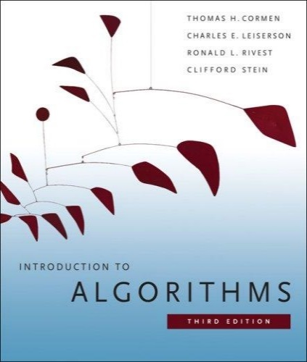
The Course
Purpose: a rigorous introduction to the design and analysis of algorithms
Not a lab or programming course
Not a math course, either
Textbook: Introduction to Algorithms::
Cormen, Leiserson, Rivest, Stein
An excellent reference you should own
Some additional materials may appear during lectures
** I appreciate feedback as we go along
** if something is a problem then tell me because it can often be fixed easily

Slide 3
The Course
Instructor: Ishtiaque Zahid
Lecturer, UIU
ishtiaque@cse.uiu.ac.bd
Office: Room #636
This course:
This Classroom, On-campus
Materials shared on eLMS
For regular group communication???

Slide 4
Assessment Tools (Tentative)
Assessment Method | (%)
Attendance | 5
Assignments | 5
Class Tests (3/4) | 20
Midterm exam | 30
Final exam | 40

Slide 5
Algorithms
Algorithm
[merriam-webster.com] A procedure for solving a mathematical problem (as of finding the greatest common divisor) in a finite number of steps that frequently involves repetition of an operation; broadly :a step-by-step procedure for solving a problem or accomplishing some end especially by a computer
[Knuth, TAOCP] An algorithm is a finite, definite, effective procedure, with some input and some output.
Notes:
http://portal.newman.wa.edu.au/technology/12infsys/html/KWH2003/KnuthAlgorDef.htm
"Finite: there must be an end to it within a reasonable time.
Definite: precisely definable in clearly understood terms, no pinch of salt type vagaries, or possible ambiguities
Effective: the steps must be actually be able to be carried out. [simple enough for someone using pencil and paper to carry out in a finite amount of time]
Procedure: the sequence of specific steps arranged in a logical order.
Output: unless there is something coming out of the process, the result will remain unknown! "

Slide 6
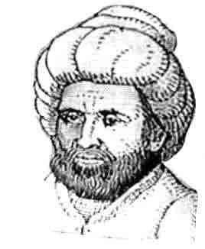
Etymology
Etymology. [Knuth, TAOCP]
Algorism = process of doing arithmetic using Arabic numerals.
A misperception: algiros [painful] + arithmos [number].
True origin: Abu 'Abd Allah Muhammad ibn Musa al-Khwarizm was a famous 9th century Persian textbook author who wrote Kitab al-jabr wa'l-muqabala, which evolved into today's high school algebra text.

Slide 7
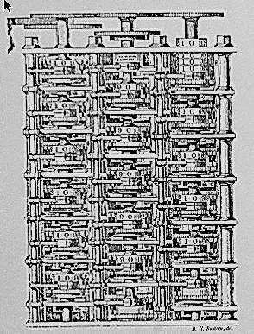
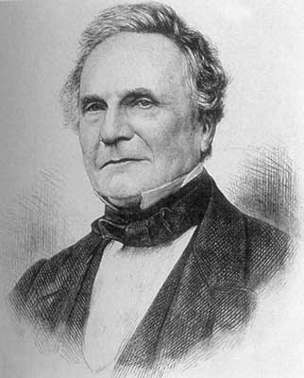
Theory of Algorithms
"As soon as an Analytic Engine exists, it will necessarily guide the future course of the science. Whenever any result is sought by its aid, the question will arise - By what course of calculation can these results be arrived at by the machine in the shortest time?” - Charles Babbage

Slide 8
Algorithmic Paradigms
Design and analysis of computer algorithms.
Greedy.
Divide-and-conquer.
Dynamic programming.
Network flow.
Randomized algorithms.
Intractability.
Coping with intractability.
Critical thinking and problem-solving.

Slide 9
Applications
Wide range of applications.
Databases.
Scheduling.
Networking.
Data analysis.
Signal processing.
Computer graphics.
Scientific computing.
Operations research.
Artificial intelligence.
Computational biology.
. . .
We focus on algorithms and techniques that are useful in practice.

Slide 10
What is Algorithm?
Algorithm
is any well-defined computational procedure that takes some value, or set of values, as input and produces some value, or set of values, as output.
is thus a sequence of computational steps that transform the input into the output.
is a tool for solving a well-specified computational problem.
Any special method of solving a certain kind of problem (Webster Dictionary)

